Slide 1

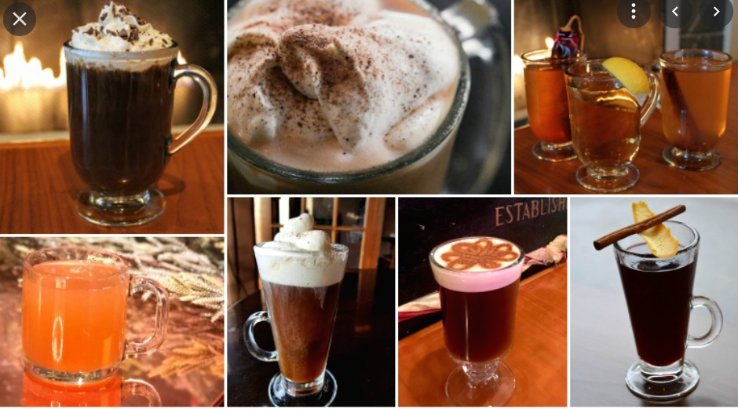

BEVERAGE & BREAKFAST SALES DATASET FOR 2011/2012/2013

Slide 2
SALES DATA FOR 2011

Slide 3
SALES DATA FOR 2012

Slide 4
SALES DATA FOR 2013

Slide 5
COMPARISION FOR 3 YEARS OF SALES

Slide 6
INFERANCE OF THE SALES EACH YEAR
Sales shows increasing trend by each year for cold /Hot/Neutral beverages & breakfast
Sales shows increasing trend by each year product wise for each year
Sales shows increasing trend by sub category wise

Slide 7
Your best quote that reflects your approach… “It’s one small step for man, one giant leap for mankind.”
- Neil Armstrong

